Slide 1
StarlingX Project Update
Learn, Try, Get Involved!
Huang Shuquan – StarlingX TSC Member
Saul Wold - StarlingX TSC Member
Starlingx.io

Slide 2
Agenda
Release schedules and our upcoming release
Future releases candidate features
Help wanted!

Slide 3
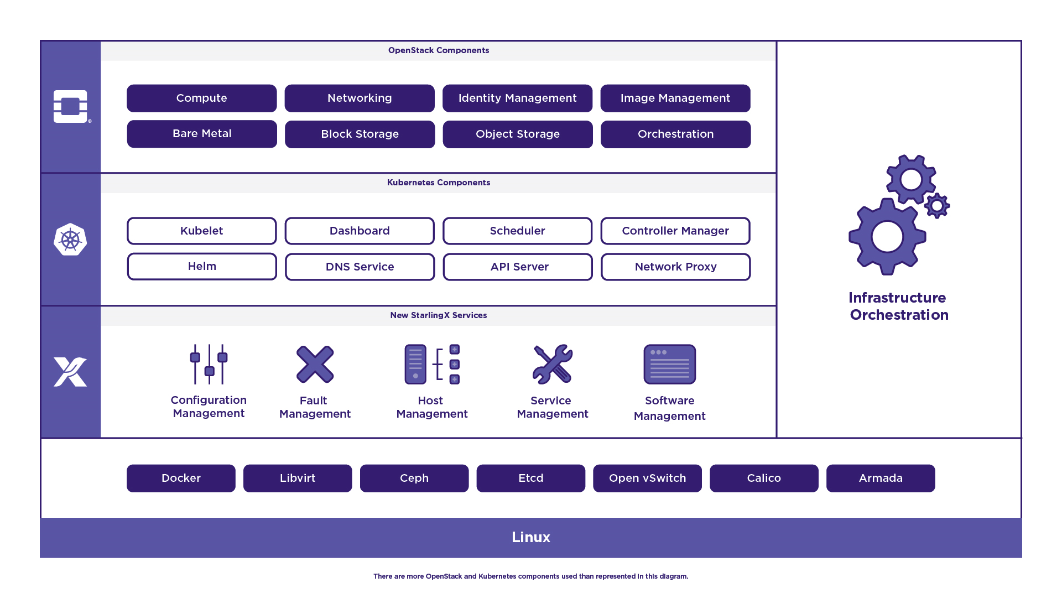
StarlingX –Edge Virtualization Platform
StarlingX provides a deployment-ready, scalable, highly reliable Edge infrastructure software platform
Services from the StarlingX virtualization platform focus on
Easy deployment
Low touch manageability
Rapid response to events
Fast recovery
Think control at the Edge, control between IoT and Cloud, control over your virtualized workloads
* Other names and brands may be claimed as the property of others
Notes:
Brent

Slide 4
StarlingX Timeline
Oct’19
2.0.1
Bug fixes & CVEs
May 2018
Project launch
October 2018
Release 1.0
OpenStack Pike with many patches
August 2019
Release 2.0
Container Platform
Containerized openstack running (Stein) with no out of tree* patches
December 2019
Release 3.0
Train Update Distributed Cloud
Q3 2020
Release 4.0
Ussuri Update
CentOS 8.x w/4.18 Kernel Python 3
* We are back-porting a few key fixes from Nova master
Notes:
Bruce

Slide 5
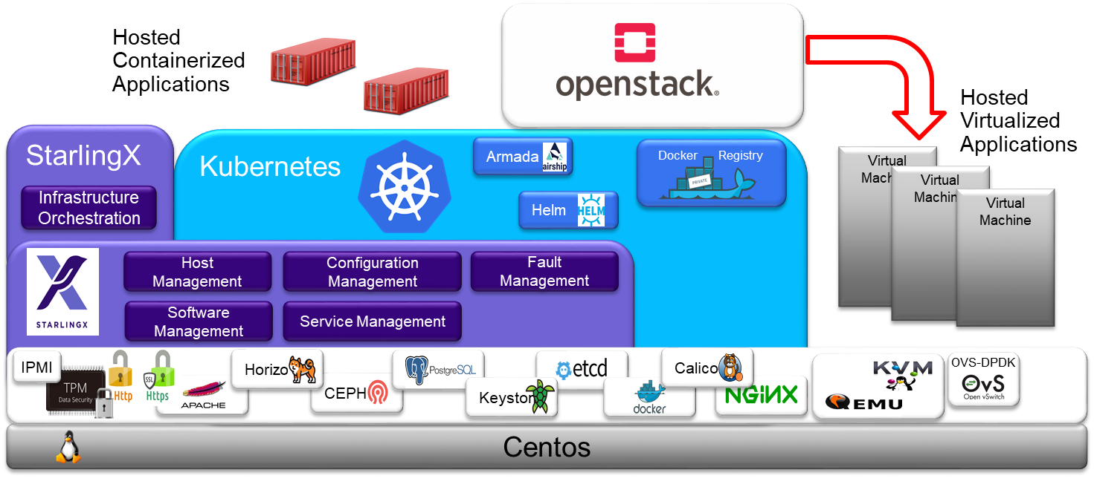
StarlingX Architecture
Kubernetes for the orchestration of container workloads
Local replicated docker image registry
Container Runtime: docker
Networking: Calico
Persistent Storage: CEPH RBD
Package Manager
HELM
Armada for orchestrating the deployment of multiple Helm charts
Integration with openstack keystone
Local docker image registry authentication
Authentication/authorization of k8s API
Notes:
Brent

Slide 6
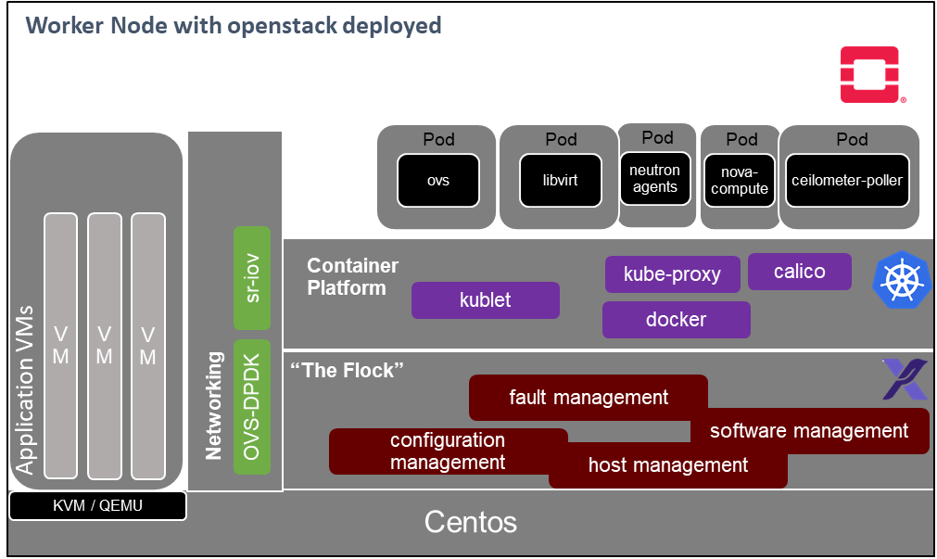
StarlingX Architecture (cont’d)
Openstack is an optional containerized application
Leverages openstack-helm and armada for deployment
Stein based for release 2
Networking back ends supported:
Containerized ovs
Bare metal ovs-dpdk
SR-IOV/PCI-PT
Supported services:
nova, neutron, glance, cinder, glance
keystone, barbican, heat, ironic,
ceilometer, aodh, panko, gnocchi
Notes:
Brent

Slide 7
StarlingX OpenStack Support
StarlingX has aligned with upstream OpenStack and uses the OpenStack-Helm charts for running the OpenStack services in containers
The exception is that the services that run outside of containers, Barbican, Horizon and Keystone.
These will remain Stein until the 4.0 update and then they will move to Ussuri.
This is due to additional platform dependencies that need to be updated that will more testing.
Notes:
Brent

Slide 8
StarlingX 3.0 Release
Will be released in December
Infrastructure Updates
Keep Core packages current
CVE & Bug fixing
Integrates OpenStack Train in the Containerized version
Includes Distributed Cloud Feature
Notes:
Brent

Slide 9
StarlingX Release 3 Content
New Functionality
Redfish
Container backup & restore
TSN Support for Vms
Infrastructure & Cluster Monitoring
Intel GPU & QAT K8S Support
Infrastructure
Performance Testing & Measurement Framework
zuul-jobs
User Documentation
Keeping Current
Kubernetes 16.2
QEMU/Libvirt updates
CVE updates
Notes:
Together

Slide 10
StarlingX 4.0 Release Planning
Ussuri Update
CentOS 8 / 4.18 Kernel / Python3
Multi-OS Support
Package Versioning via PBR
Layered build
Test Improvements
Unit, Functional, Integration
Additional Performance tests
 | Ussuri Timeline | StarlingX Plan
Milestone-1 | 12/13/2019 | 1/24/2020
Milestone-2 | 2/13/2020 | 3/27/2020
Milestone-3 | 4/10/2020 | 5/15/2020
RC-1 | 4/24/2020 | 6/12/2020
Release | 5/15/2020 | 7/3/2020
Notes:
Bruce

Slide 11
StarlingX Future Feature Candidates
Container Platform
Support for additional container run times
EPA features
Direct device access from containers ex: GPUs FPGAs
Accelerated container networking
VM and container coexistence on the same host
Kubevirt integration, support VM’s in a k8s only environment
Multi-tenancy support for containers
HA enhancements
New functionality
Edge device management
Time Sensitive Networking and MQTT protocol support for industrial use cases
Integrating higher level projects (i.e. EdgeX)
Infrastructure
Deployment evolution
Multi-OS Host OS support
Staying current with upstream projects (i.e. k8s, openstack)
Test evolution – test build out and test in the open
Notes:
Together

Slide 12
What’s next?
We are actively working on our next release and will be planning the following release this week. Please feel free to join our PTG session
Wednesday All day and Thursday Morning in Room 430!
Additional StarlingX summit sessions:
Expanding Scope: Edge Computing Working Group Update Mon 4, 1:20pm – 2:00pm, Room 618
StarlingX: Hardware Acceleration Driven Network Policies on Edge, Mon 4, 3:35pm – 3:45pm, Marketplace Theater
China Unicom's Edge Orchestration System In 5G To Manage StarlingX, K8S And OpenStack EdgeDC, Tue 5, 10:50am – 11:30am, Room 618
StarlingX's Hybrid Distributed Cloud - Supporting Kubernetes And/Or OpenStack Edge Clloud. Tue 5, 1:40pm - 2:20pm, Room 619
Secured Edge Infrastructure For Contactless Payment System Tue 5, 3:20pm – 4:00pm, Room 618
How China Telco Carriers think of Edge Computing?, Tue 5, 4:20pm – 5:05pm, Room 619
How To Achieve Coordination And Management Of Heterogeneous And Multi-vendor Cloud On Telco Edge? Wed 6, 11:40am – 12:20pm, Room 619
An Edge Framework Helping Object Recognition Wed 6, 2:45pm – 2:55pm, Marketplace Theater
Notes:
Bruce

Slide 13
t
A Fully Featured Cloud
For The Distributed Edge
Join the Community
Mailing Lists: lists.starlingx.io Freenode IRC: #starlingx
Website: www.starlingx.io
Join the Foundation mailing list to stay up to date on all new projects!

Slide 14
Thank You!

