Slide 1
Kata Containers Integration in STX

Slide 2
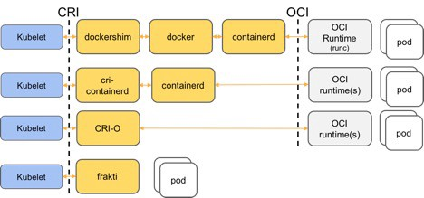
Kubernetes Runtimes
Docker
Containerd
CRI-O
Current flow:
RunC
RunC
New flow:
Kata
Notes:
https://kubernetes.io/docs/setup/production-environment/container-runtimes/
https://medium.com/kata-containers/why-kata-containers-doesnt-replace-kubernetes-75e484679727

Slide 3
 | Docker | Containerd
package | Rpm from docker repo | Tarball from containerd community
Config file | /etc/docker/daemon.json | /etc/containerd/config.toml
Runtime dir | /var/lib/docker (a 30G dedicated partition to store container image) | Default is /var/lib/containerd Config to /var/lib/docker the same as docker, in order to avoid 2 disk partition for container
CLI | docker | crictl: support most container operation like docker. Doesn’t support push cmd. Need use docker to pull/push image to local registry
SDK | Python SDK | No Use subprocess to call crictl to do the operation.
Insecure registry | Config in daemon.json | Config in config.toml
Secure registry with auth | Docker login | Config in config.toml/pass parameters in crictl
proxy | http-proxy.conf | Share the same format conf file as docker.

Slide 4
How to select kata runtime?
By default it is with runc, need select kata explicitly in pod spec:
Annotation (Deprecated)
apiVersion: v1
kind: Pod
metadata:
annotations:
io.kubernetes.cri.untrusted-workload: "true"
Config in containerd:
[plugins.cri.containerd.untrusted_workload_runtime]
runtime_type = "io.containerd.kata.v2“
Runtime Class(Recommended)
kind: RuntimeClass
apiVersion: node.k8s.io/v1beta1
metadata:
name: kata-containers
handler: kata
---
apiVersion: v1
kind: Pod
spec:
runtimeClassName: kata-containers
Config in containerd:
[plugins.cri.containerd.runtimes.kata]
runtime_type = "io.containerd.kata.v2"
Notes:
https://kubernetes.io/docs/concepts/containers/runtime-class/

Slide 5
Main Task
Add kata repo, add kata rpm to iso.
Add containerd/runc src tarball, and crictl binary.
Configure kubelet/kubeadm to use containerd.
Configure containerd to support proxy/insecure registry/secure registry(local registry) etc.

Slide 6
Test has been done
Pass AIO-SX/AIO-DX/Multi node deployment with below 3 cases:
without private registry + no proxy
with private registry + no proxy
with private registry + proxy
Verified vm could be created successfully by openstack and kata container could be run successfully also.
Swact/lock&unlock/remove&apply application.
Sanity & Regression test is under going.

