Slide 1
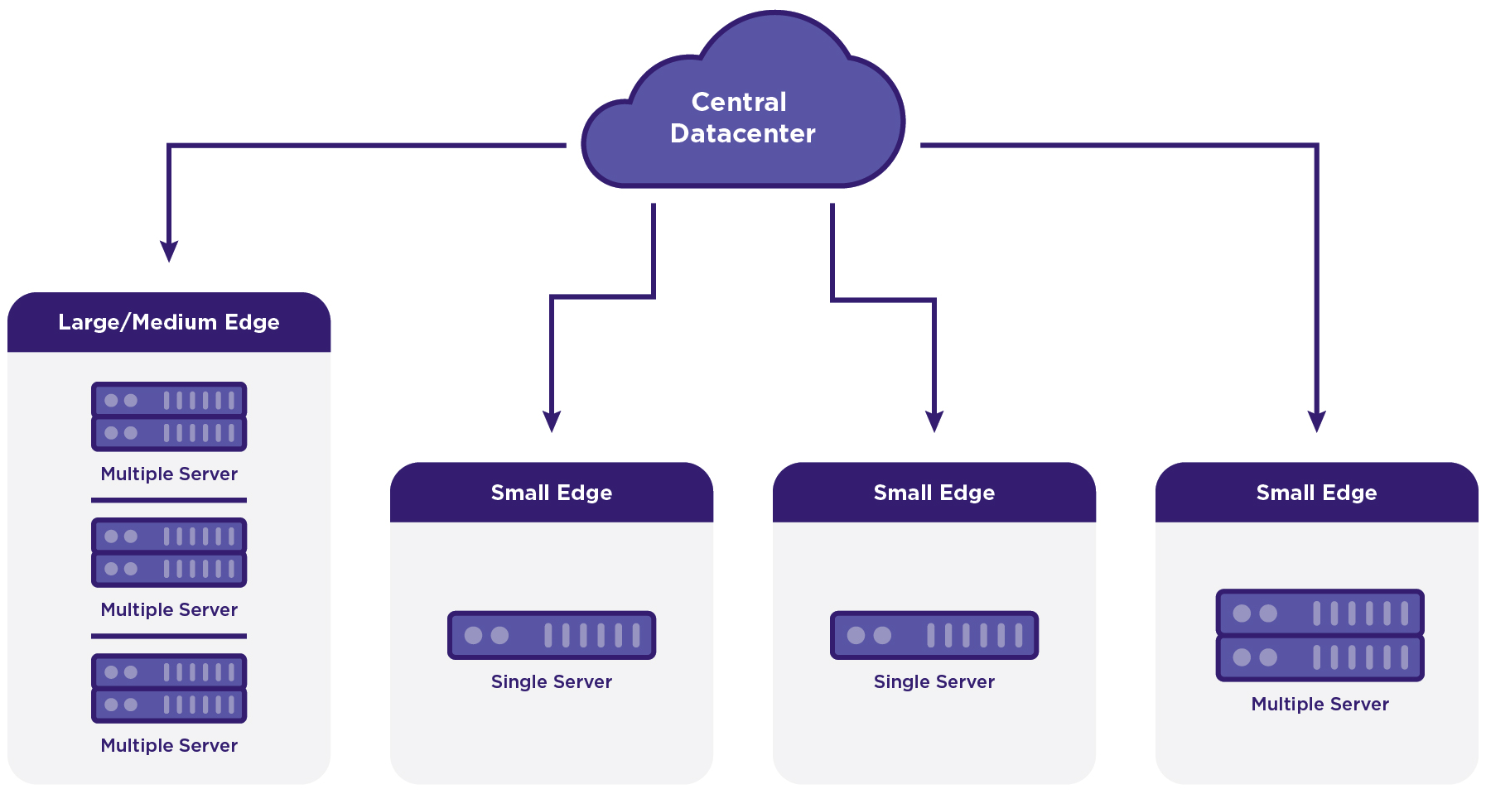
Scaling from the Core to the Edge
Geographically distributed multi-region deployment
Geo-Redundant Central Datacenters,
Geographically distributed Edge Sites of various sizes,
Central Datacenter providing Orchestration and Synchronization Services.
Central Datacenter
DC synch
Central Datacenter
Notes:
The architecture is designed to scale based on the needs of the particular Edge computing environment. The same platform can run on:
Single Server
Running Controller, Compute, Networking and Storage functions,
Supported on small hardware form factor
Dual Server
Each Server running Controller, Compute, Networking and Storage functions,
Controller, Networking and Storage functions run HA across two servers,
Supported on small hardware form factor
Multiple Server
Controller, Compute and Storage functions all running on independent servers,
2x Node HA Controller Node Cluster
2-100x Compute Node Cluster
OPTIONAL 2-9 Node CEPH Storage Node Cluster
And L3 Networking services distributed across compute nodes.

